Slide 1
WELCOME TO NEXTHIKES Advanced Calculator

Slide 2
Title & Introduction
Title: Python Advanced Calculator
Subtitle: A versatile tool for math & trigonometry
Overview: Purpose of the project — combining arithmetic, trigonometric, and logarithmic functions in one calculator.

Slide 3
Project Objectives
Provide a user-friendly calculator for advanced math operations
Support basic arithmetic (+, −, ×, ÷).
Include trigonometric functions (sin, cos, tan, etc.).
Add logarithmic and power functions.

Slide 4
Features & Functionality
Basic Operations: Addition, subtraction, multiplication, division.
Advanced Math: Power, square root.
Trigonometry: sin, cos, tan, asin, acos, atan.
Logs: Natural log (log), base-10 log (log10).
Error Handling: Division by zero, invalid inputs.

Slide 5
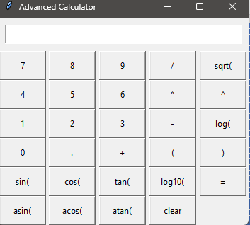
Conclusion & Next Steps
Summary: A robust calculator for math & trigonometry.
Benefits: Easy to use, extendable, educational.

Slide 6
THANK YOU

